Slide 1
Introduction to R for Development Data Analysis
AUDENCIA · INTERNATIONAL DEVELOPMENT · NOVEMBER 2026
Programming in R in 2026
Kate Chalmers
Data scientist and analyst, OECD WISE Centre
13 November 2026
Notes:
08:00. Welcome everyone. Six hours of contact time: four hours in the morning with two short breaks, then two hours after lunch for the group project. Fill in programme, date and room.

Slide 2
Who is teaching you today
OPENING · ABOUT ME
Data scientist and analyst at the OECD, in the Well-being Data Insights and Policy Practice team at the WISE Centre (Well-being, Inclusion, Sustainability and Equal Opportunity).
I manage the OECD Well-being Database and the Well-being Data Monitor
I use R almost every day, most often for ad-hoc and exploratory analysis
I co-lead R-Ladies and Friends at the OECD
MY BACKGROUND
Studied economics in the US and France and have been at the OECD for 6 years
R for Development Data · Audencia · Opening
Notes:
08:00 to 08:04. Keep this short and human. The point is: I am a working analyst, R is the tool I use every day, not just a classroom exercise.

Slide 3
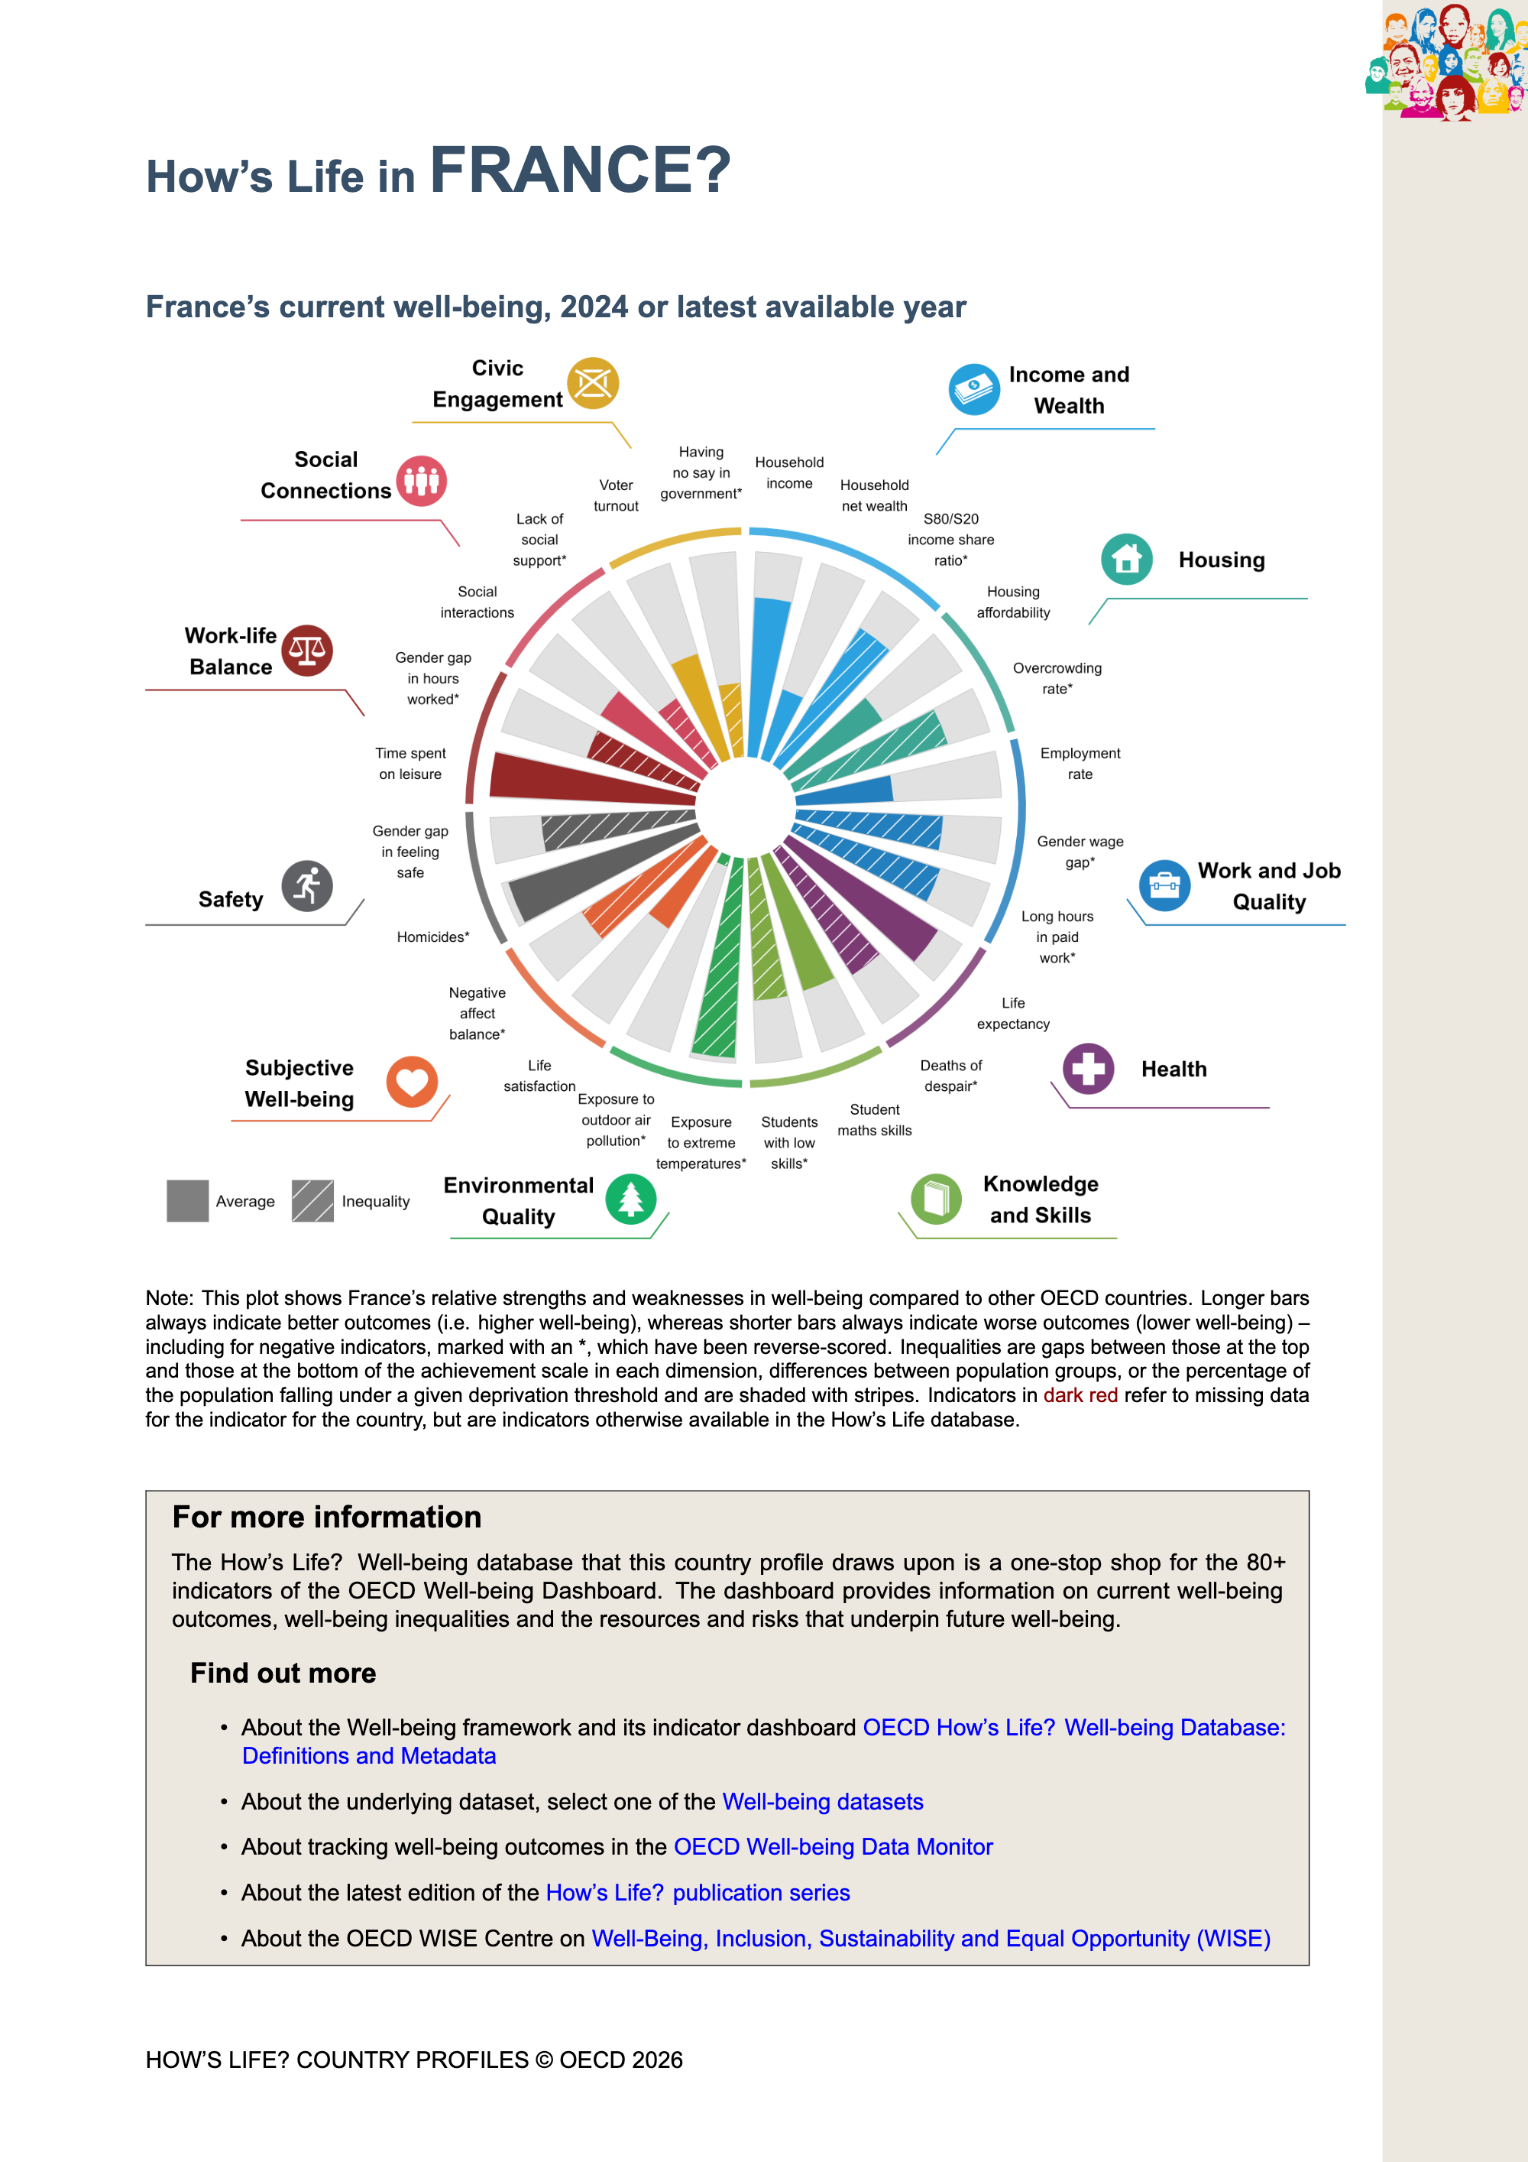
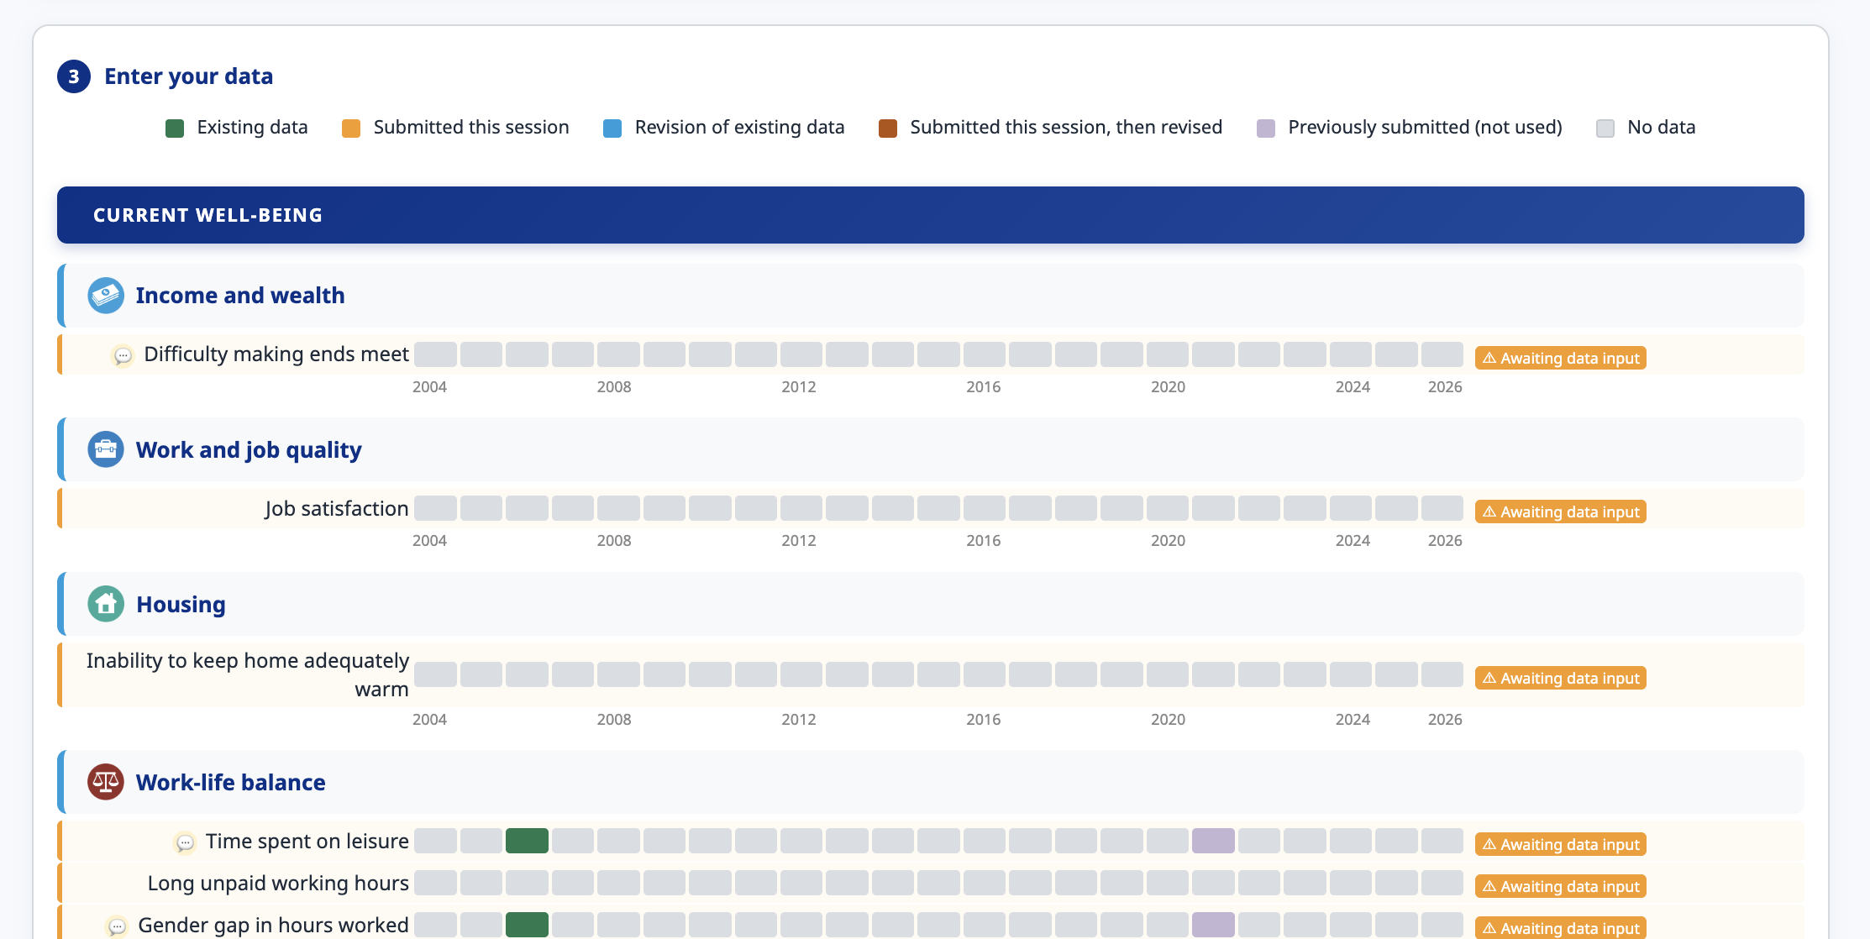
What data work looks like at the OECD
OPENING · MY WORK
1 · Collect
Indicators from mircodata, surveys, APIs and national statistical offices
2 · Clean
Harmonise definitions across countries and years, flag gaps
3 · Communicate
Reports, charts, country profiles and notes that policy makers can use
Notes:
08:04 to 08:08. Collect, clean, communicate is the arc of today too: we will load data, analyse it, and plot it. Show one real chart and say what decision or debate it fed into.

Slide 4





Quick show of hands
QUESTION FOR THE ROOM
I have written code before, in any language
I have analysed data in Excel
I have used R or Python
I have asked an AI to write code for me
Notes:
08:08 to 08:12. With 35 to 40 people, hands are much faster than a round of introductions. The answers tell you how fast to go in Block 2. Ask the confident coders to sit next to beginners: they become your helpers for the day.

Slide 5
We will work in four blocks today
OPENING · AGENDA
Time | Block | What we do | Goal
08:00 to 09:15 | 1 · Why R, and how coding has changed | R versus other tools, AI and code | Context
09:30 to 10:45 | 2 · Getting set up | Install R and Positron, first script, packages | Ready to code
11:00 to 12:15 | 3 · Load, analyse, plot | Import files, the five dplyr verbs, ggplot2 | Goals 1, 2 and 3
13:30 to 15:30 | 4 · Mini data project | Groups analyse real development data and present one plot | All three, on your own
Breaks: 09:15 and 10:45 (15 minutes each) · Lunch: 12:30 to 13:30
Notes:
08:18. Six hours of contact time: four in the morning, two in the afternoon. The morning teaches the tools; the afternoon is where students use them on their own. Adjust lunch to the Audencia timetable if needed.

Slide 6



Three goals
OPENING · GOALS
1 · Load data
2 · Analyse
3 · Build a plot
Bring a CSV, Excel or Stata file into R and view it in your IDE
Filter, transform and summarise data to compare groups
Turn a question into a clear, labelled, shareable chart
read_csv()
filter() summarise()
ggplot()
Notes:
08:20. These three goals structure Block 3, and the afternoon project uses all three on real data. Come back to this slide at the very end so students can tick them off.

Slide 7

By the end of today, you can…
OPENING · LEARNING OUTCOMES
Install and open R and Positron (or Rstudio)
Filter, transform and summarise data
Write, run and save an R script
Build, label and save a ggplot chart
Import a dataset and inspect it
Read AI-written code critically
Not the goal today: memorising functions. The goal is knowing what to ask for, and how to check the answer.
Notes:
08:22. The last outcome, reading AI-written code critically, is new this year and sets up the section on how coding has changed.

Slide 8




How the day works
OPENING · FORMAT
Live coding
Errors are normal
I type, you type the same code. No copy and paste.
An error message is information. We’ll look at them together.
Signal early
Ask a neighbour
Sticky note on your screen: one colour for “done”, another for “stuck”.
Neighbour first, then me. Explaining is how you learn.
Notes:
08:23 to 08:25. Hand out two colours of sticky notes: they come back at the end of the day. Say which colour means stuck. With 40 students you cannot reach everyone quickly, so the neighbour rule matters. Share the materials link now.

Slide 9
Why R?
BLOCK 1 · PART 2
What R is, how it compares with other tools, and why it is so common in development and policy work
Notes:
08:25 to 08:42. About 17 minutes for this part, including one pair question.

Slide 10
What is R?
WHY R · DEFINITION
A free programming language and environment built by statisticians, for working with data: cleaning it, modelling it and plotting it.
1990s
Free
20,000+
Created by Ross Ihaka and Robert Gentleman at the University of Auckland
Open source, runs on Windows, macOS and Linux, without a license
Add-on packages on CRAN, from survey weights to maps
Notes:
08:25 to 08:29. Key message: R was designed for data analysis from day one, which is why so many statistical methods appear in R first.

Slide 11
R compared with other common tools
WHY R · COMPARISON
 | R | Python | Stata | Excel
Cost | Free | Free | Paid licence | Paid licence
Strongest at | Statistics, charts, reports | General programming, machine learning | Econometrics, survey data | Quick tables, small data
Record of work | Scripts | Scripts | Do-files | Hard to trace
Typical users | Statistical offices, research, NGOs | Tech firms, data engineering | Applied economists | Everyone
Most skills transfer: data tables, functions and plots exist in all four.
Notes:
08:29 to 08:34. Not a contest. Excel is fine for quick looks, Stata dominates applied economics, Python dominates tech. R’s edge for this programme: free, strong on statistics and charts, widely used by statistical offices and international organisations.

Slide 12
R in development and policy work
WHY R · IN PRACTICE
Where you will meet it:
Data straight from the source:
International organisations and statistical offices
Impact evaluation and academic research
NGOs and think tanks publishing data stories
# World Bank indicators
library(WDI)
WDI(
country = c("SN", "KE", "BR"),
indicator = "SP.DYN.LE00.IN",
start = 2000, end = 2022
)
TO FILL IN
[An example from your own OECD work where R saved time or caught an error]
Also: rsdmx for OECD and other SDMX sources, haven for Stata and SPSS survey files.
Notes:
08:34 to 08:37. The WDI call downloads life expectancy for Senegal, Kenya and Brazil in one line. No downloading spreadsheets by hand. We will not run it now; it shows that data can come straight from the source, as it will this afternoon.

Slide 13
“Should I learn R or Python?”
WHY R · THE USUAL QUESTION
Pick one and stick to it, the skills will transfer
Same concepts
Reasoning is the most important
AI has facilitated cross-over
Data frames, functions, grouping and plotting work the same way in both
Can you get from a messy file to a defensible answer?
If you know one language well, AI makes it much easier to work in another
Notes:
08:40 to 08:42. The third card is the bridge to the next part: Hadley Wickham makes exactly this point, that knowing how to program in one language now lets you work in many.

Slide 14
y code when ai?
BLOCK 1 · PART 3
How coding has changed with the advent of Github Copilot and Claude Code
Notes:
08:42 to 09:15. About 33 minutes, opening and closing with a question for the room. The talk title is deliberately lowercase and terse, read it out as “why code when AI?”.

Slide 15
Would you trust a policy brief whose analysis was done entirely by AI?
QUESTION FOR THE ROOM
Yes
No
It depends
Notes:
08:42 to 08:45. Write the “it depends on…” answers on the board: who checked it, which data, what the stakes are. Leave them up: we come back to this vote at the end of the section, and Hadley’s argument mostly lands on “it depends on whether a person checked it and answers for it”.

Slide 16

Some ideas from Hadley Wickham
HOW CODING HAS CHANGED · SOURCE
Chief Scientist at Posit, the company behind RStudio and Positron
Created ggplot2 and dplyr, the tools we will use this afternoon
Co-author of R for Data Science, one of key reference books for R
The talk: y code when ai?
Given at Bocconi (April 2026) and an ASA webinar (May 2026), then written up on his Substack, Tidy design principles (July 2026)
Notes:
08:45 to 08:47. Source: tidydesign.substack.com/p/y-code-when-ai. His point of view matters because he built the tools and now writes most of his own R code with AI, yet still argues that learning to code is worth it.

Slide 17

How we used to code and how we code now
HOW CODING HAS CHANGED · THEN AND NOW
Until recently
In 2026
Type every line yourself
Search Stack Overflow and the docs
Copy, paste, adapt
Fix errors by trial and error
Describe what you want in words
A model writes, runs and revises code
You review, test and decide
The hard part moves from typing to judging
Notes:
08:47 to 08:50. Ask: who has already used ChatGPT, Claude or Gemini to write code? Hadley notes a step change around the end of 2025, when coding agents became genuinely useful. Opinions formed even a year ago are out of date.

Slide 18
The genie is out of the bottle
HOW CODING HAS CHANGED · BIG PICTURE
Whatever you think of AI, it is not going away, so the question is how to use it well.
The costs
The promise
Environmental impact
More concentration of wealth
Built on other people’s work, used without consent
Coding becomes a conversation
Genuinely fun and empowering
One person can build far more than before
HOW HAS MY WORK CHANGED?
I still will write my own code first in R to set up what I want and then have AI polish it – moving iteratively from there
Notes:
08:50 to 08:52. For development students the costs are a live debate (energy, labour, concentration of power). Acknowledge them, then move to practice. Example from his talk: he built an iPhone app in a couple of hours without knowing Swift.

Slide 19
AI is an amplifier.
HOW CODING HAS CHANGED · THE KEY IDEA
It amplifies whatever you bring: shortcuts and zero effort, or curiosity, scepticism and depth.
Notes:
08:52 to 08:54. Pause here. His argument for why statisticians and data people are well placed: we can already program, we are trained to ask who collected the data and why, and we understand variation, which matters because these models are random by nature. Development students have that same scepticism about sources.

Slide 20

“It’s still your work”
HOW CODING HAS CHANGED · RESPONSIBILITY
PATH A · QUANTITY
PATH B · QUALITY
The software factory
Better work, not just more
Feed the machines ideas and ship more, faster, with less thought. Fine for quickly evaluating ideas.
Spend the time AI saves on checks, documentation and clear structure. This is where your best work comes from.
However the code was produced, you are the one who will answer for it. In this course: you must be able to explain every line you hand in.
Notes:
08:54 to 08:57. The quoted title is Hadley’s own slide. He notes both paths are legitimate depending on stakes: he happily has AI throw together a quick Shiny app to explore something, but goes for quality on work that matters. A policy brief based on your analysis is work that matters.

Slide 21
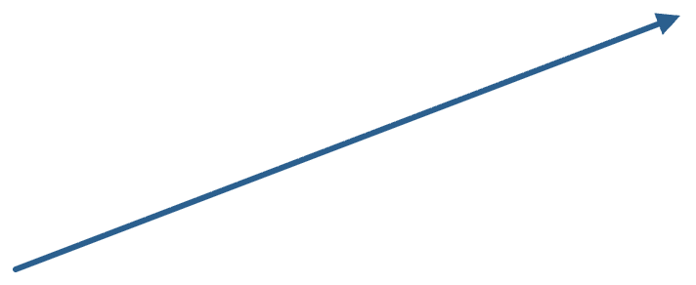
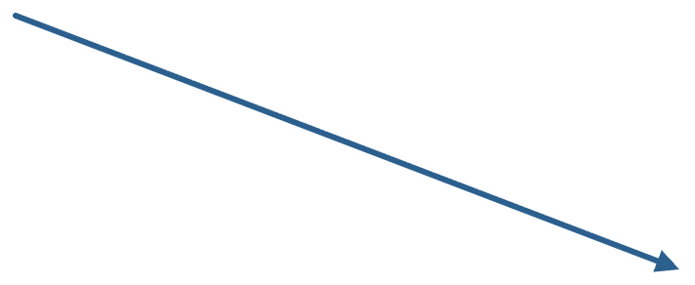
Beyond the chat window
HOW CODING HAS CHANGED · PRACTICE
1 · Write code that uses an LLM
For example the ellmer package: turn free text, PDFs or images into a tidy table
Chat window
Copy code out, paste errors back in
2 · Let the LLM write and run code
Posit Assistant or a coding agent inside Positron: it can see your data, variables and plots
Chatbots are fine for everyday questions, but for coding and data work they leave most of the value on the table.
Notes:
08:57 to 09:00. Copy-pasting between a chatbot and your editor gives the AI the fun part (thinking about code) and leaves you the tedious part (shuttling text). Path 1 is powerful for development data: reports, PDFs and scanned forms become rows and columns. Path 2 is what students may try in the afternoon project.

Slide 22
The feedback loop is the engine
HOW CODING HAS CHANGED · WHY AGENTS WORK
Write code
Run it
Models are sometimes brilliant and sometimes plainly wrong. Running their own code lets them grind their way to an answer anyway.
repeat until it works
They also do something many beginners skip: they read the error message.
Your lesson for today: run often, and read every error.
Revise
Read the output, errors and docs
Notes:
09:00 to 09:02. Hadley’s joke is that LLMs beat humans at one thing: actually reading error messages. In R, reading documentation is just another function call, so an agent can look things up too. This loop is the same one students will use all afternoon.

Slide 23

Why data analysis is harder to automate
HOW CODING HAS CHANGED · LIMITS
Software engineering
Data analysis
You usually know what the right output is. Automated tests check it, like double-entry bookkeeping for code.
You are looking for an answer nobody knows yet. No test can say whether a chart is informative or a model is right.
Posit’s bluffbench test secretly reversed a relationship in a familiar dataset.
Asked to describe the plot, models reported the expected pattern instead of the real one about 80% of the time.
This is because models often look to confirm their assumptions instead of using the evidence (just like people!).
So: look at your data yourself.
Notes:
09:02 to 09:05. This is the slide that justifies the whole course. In data work the AI has to check in with you far more often than in software work, because only you can judge whether the result makes sense. The bluffbench example: engine size versus fuel economy in the mtcars data was flipped, and most models just read the axis labels and described what they expected.

Slide 24




So why learn to code at all?
HOW CODING HAS CHANGED · SO WHAT?
Hadley’s answer: it is a better time to learn than ever. Code is no longer just how you instruct a computer; it is evidence.
A record of reasoning
Reproducible
A script shows every decision you made, in order
Anyone can rerun it next year on new data
You must judge it
Your knowledge counts
You cannot check code you cannot read
Who collected the data, how, and why: the AI does not know
Notes:
09:05 to 09:07. Link to development work: survey design, sampling, definitions that change across countries. That knowledge is what makes your analysis trustworthy, with or without AI. Hadley also suggests writing a data dictionary: describing each variable helps human colleagues and AI tools alike.

Slide 25
Using AI in this course
HOW CODING HAS CHANGED · OUR RULES
1
No AI in the morning, try to understand the basics on your own first
2
Stuck? Ask your neighbour, me, and AI as last resort
3
You will need to be able to explain every line (no overengineering!)
4
Say when and how you used AI
Notes:
09:07 to 09:09. These are suggested defaults, adjust them. Rule 1 matters most: the afternoon project is where AI comes in, once students can read what it writes.

Slide 26
Where could an AI-written analysis of development data go quietly wrong?
QUESTION FOR THE ROOM
IF YOU ARE STUCK
Selects its own survey weights
Country codes mismatched
Missing values read as zero
Definitions that changed over time
Prices not adjusted for inflation
AI BIAS IN MY WORK
Outliers not identified, biased plots, context and sensitivities are not considered, overengineered code with hidden assumptions
Notes:
09:09 to 09:15. Show the question first and reveal the hints only if pairs are stuck. The revote closes the loop with the vote at 08:42 and usually shifts people towards “it depends”. Close the block: everything we learn today is about being able to spot these problems.

Slide 27

Break
15 minutes · back at 09:30
If you haven’t installed R yet, open cloud.r-project.org and start the download now, so it is ready when you return.
Notes:
09:15 to 09:30. Starting downloads before the break saves ten minutes in Block 2, especially on slow Wi-Fi with 40 laptops.

Slide 28
Getting set up
BLOCK 2 · 09:30 TO 10:45
Install R and Positron, write your first script, and learn objects, functions and packages
Notes:
09:30. Installation always takes longer than planned, and 40 laptops means 40 setups: if you can, email students beforehand asking them to install R and Positron before the day. Have a backup: Posit Cloud (posit.cloud) in the browser for anyone whose laptop will not cooperate.

Slide 29


Two pieces of software
SETUP · OVERVIEW
R
+
Positron
The engine: the language that does the computing. You install it, then rarely open it directly.
The dashboard: where you write code, run it, and see data and plots. This is what you open every day.
If you already have Rstudio you can use that. The essentials are the same.
Notes:
09:30 to 09:32. Positron is Posit’s newer, free editor for data science with R and Python. RStudio is still maintained, so students who already have it do not need to switch.

Slide 30
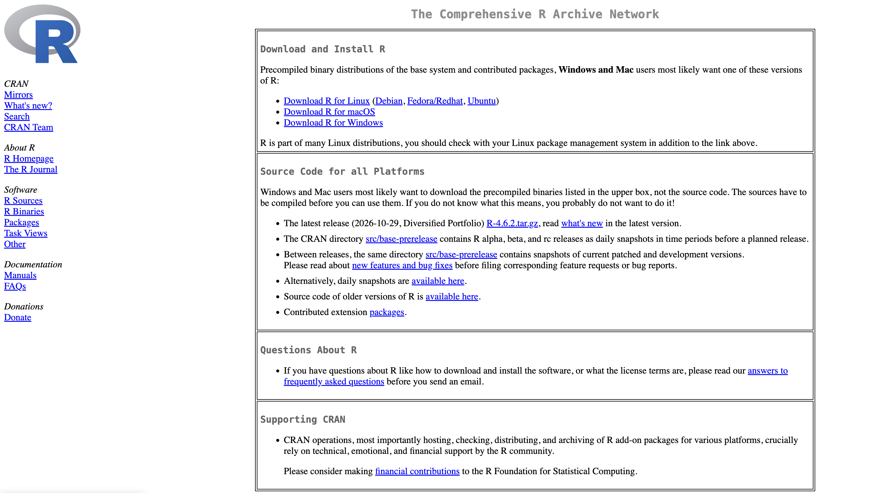
Install R
SETUP · STEP 1 OF 2
Go to cloud.r-project.org
Choose your operating system
Download the latest release
Run the installer with the default options
Mac users: pick the Apple silicon (arm64) build for newer Macs, Intel for older ones.
Positron needs R 4.2 or newer (if you already had R installed check this)
Notes:
09:32 to 09:40. Walk the room. Common problems: no admin rights on a work laptop, old macOS versions, antivirus blocking the installer.

Slide 31
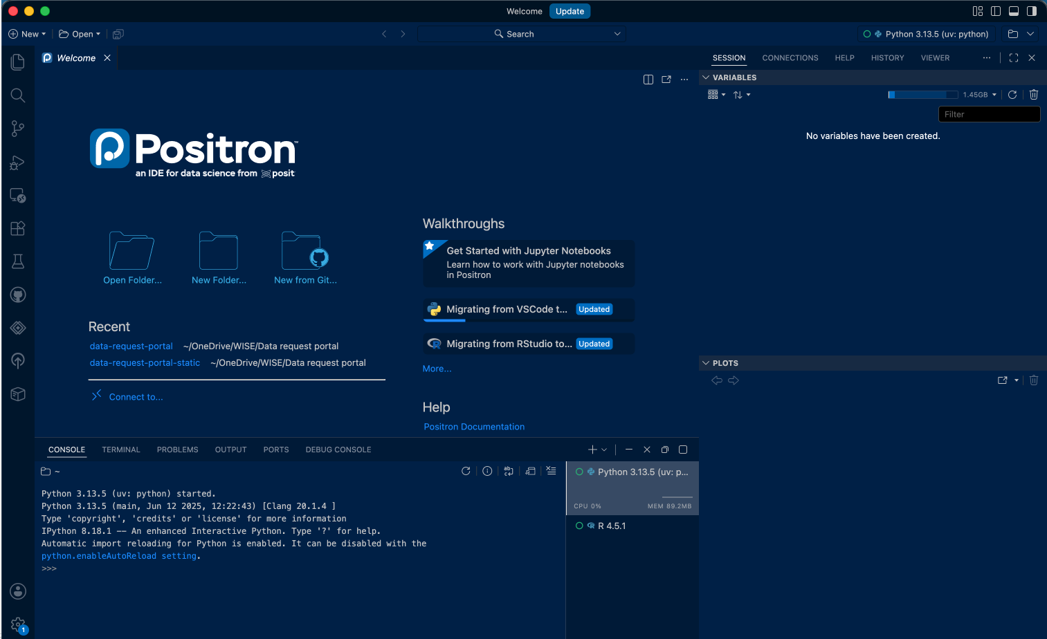
Install Positron
SETUP · STEP 2 OF 2
Go to positron.posit.co
Click Download and accept the licence
Install it like any other app
Open Positron: it should find R by itself
Free, works with R and Python, built on the same open-source base as VS Code, and updates itself.
Notes:
09:40 to 09:48. Check: in the console, R’s version number should appear when the session starts. If Positron cannot find R, R was probably not installed or needs a restart of Positron.

Slide 32
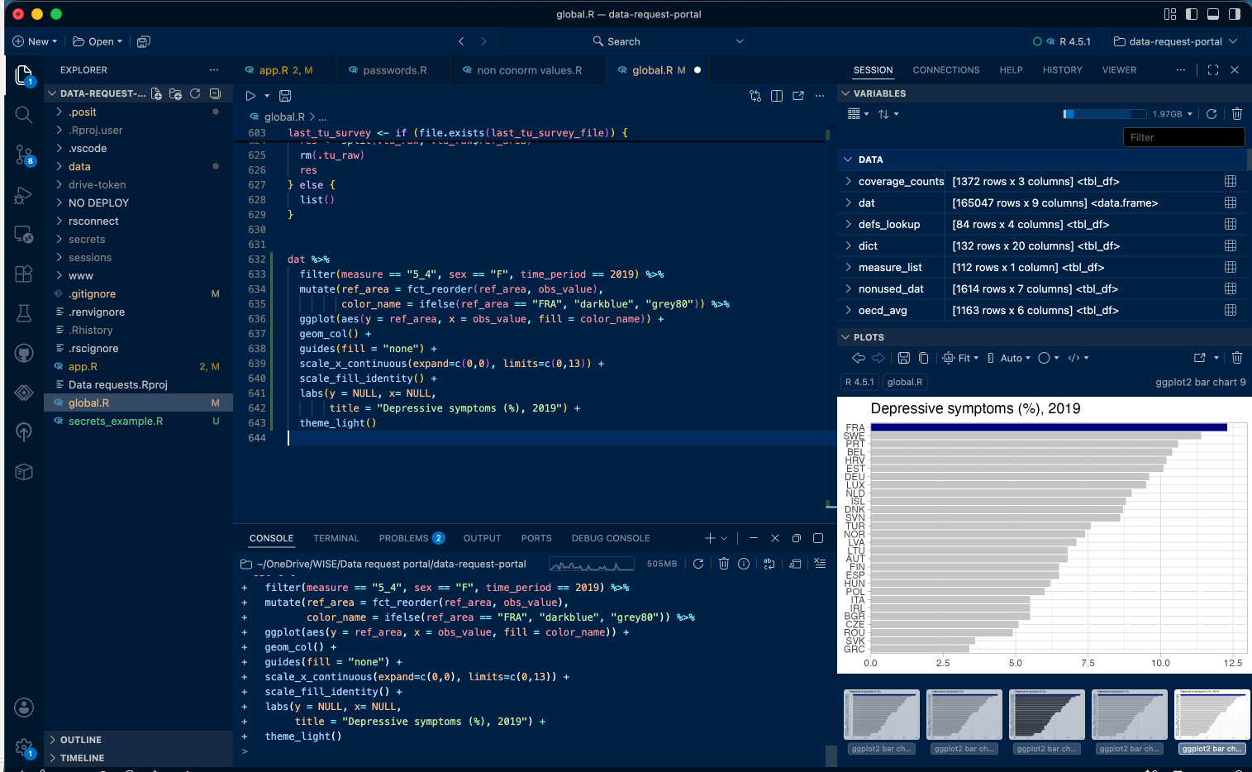
A tour of Positron
SETUP · ORIENTATION
Notes:
09:48 to 09:53. Point at each pane on your own screen. The two outlined panes, Editor and Console, are where students spend most of the day. Mention that Positron also has a built-in AI assistant; we leave it off until the afternoon project.

Slide 33
Work inside one project folder
SETUP · ORGANISATION
audencia-r/
├── data/
│ └── raw files, never edited
├── scripts/
│ └── 01-basics.R, 02-data.R
└── outputs/
└── figures and tables
Create a folder called audencia-r
In Positron: go to File, then Open Folder
Add the three subfolders
Why? paths like "data/gapminder.csv" then work on any computer. Raw data should always remain untouched; everything else can be rebuilt from the scripts.
Notes:
09:53 to 09:57. Same advice as R for Data Science: work in a project, avoid setwd() with a path that only exists on your laptop. Never overwrite raw data; at the OECD we keep raw extracts read-only for the same reason.

Slide 34
Your first script
SETUP · FIRST CODE
New file, save as scripts/01-basics.R
Run the current line
# 01-basics.R
# My first R script
1 + 1
sqrt(16)
100 / 7
Ctrl + Enter on Windows, Cmd + Enter on Mac
Comments start with #
R does not run these lines. Write them for your future self.
Console or script?
The console is for experimenting with one or two lines. A script keeps a record of the choices you make.
Notes:
09:57 to 10:01. Everyone types this, runs each line, and sees the output in the console. Callback to the morning: the script is the record of reasoning Hadley talked about.

Slide 35
Objects: storing values with <-
SETUP · R BASICS · R4DS CHAPTER 2
x <- 3 * 4
x
#> [1] 12
primes <- c(2, 3, 5, 7, 11, 13)
primes * 2
#> [1] 4 6 10 14 22 26
<-
Read it as “gets”: x gets 3 times 4
c()
Combines values into a vector
a_b
Name objects in snake_case: life_exp_2007
Aa
R is case-sensitive: Country and country are different objects
Notes:
10:01 to 10:07. From R for Data Science, chapter 2 (Workflow: basics). Watch the Variables pane fill up as objects are created. Lines starting with #> show the output.

Slide 36
Functions and arguments
SETUP · R BASICS
round
(3.14159,
digits = 2
)
FUNCTION
INPUT
NAMED ARGUMENT
seq(from = 1, to = 10)
mean(c(4, 8, 15, 16, 23, 42))
toupper("dakar")
Functions take inputs, run them systematically, and return a result.
Using named arguments makes code easier to read, for you and for anyone checking it.
Notes:
10:07 to 10:11. Show what happens without digits = 2. The next slide turns prediction into a quick vote.

Slide 37
Predict the response then run yourself
QUESTION FOR THE ROOM
LINE 1
LINE 2
LINE 3
round(2.5)
c(1, 2, 3) * 2
"10" + 1
What will R print?
What will R print?
What will R print?
Notes:
10:11 to 10:15. Answers: (1) 2, not 3: R rounds exact halves to the nearest even number, following the IEC 60559 standard. (2) 2 4 6: the maths applies to every element. (3) An error, “non-numeric argument to binary operator”, because "10" in quotes is text. Line 3 matters most: numbers stored as text are the most common problem in real data, and it may come up this afternoon.

Slide 38
Every value has a type
SETUP · R BASICS · DATA TYPES
Type | Looks like | class() says | In development data
Numeric | 63.1 or 2007 or 2.5e6 | "numeric" | Life expectancy, GDP, population
Character | "Kenya" or "KEN" | "character" | Country names, codes, regions
Logical | TRUE or FALSE | "logical" | Landlocked? Data reported?
Integer | 2007L | "integer" | Whole numbers; R uses numeric by default
Missing | NA | any of the above | A value nobody reported
class(63.1)
#> [1] "numeric"
class("Kenya")
#> [1] "character"
class(TRUE)
#> [1] "logical"
Two others: factor (categories with a set order, such as income groups) and Date.
Notes:
10:06 to 10:10. Link back to the previous slide: "10" + 1 failed because "10" in quotes is character, not numeric. Quotes are the visual clue for text. The type decides what R lets you do: you can average numbers, not names. Students type the three class() lines.

Slide 39
Which type is each value?
QUESTION FOR THE ROOM
"Senegal"
63.1
FALSE
"2007"
2007
Type?
Type?
Type?
Type?
Type?
Notes:
10:10 to 10:13. Answers: character, numeric, logical, character, numeric. The trap is "2007" in quotes: it looks like a year but it is text, so "2007" + 1 fails. Bonus: plain 2007 is numeric, not integer; integer needs 2007L. Real files do this to you all the time: a year or a population stored as text.

Slide 40
A vector holds one type only
SETUP · R BASICS · DATA TYPES
c(1, 2, "three")
#> [1] "1" "2" "three"
as.numeric(c("1", "2", "three"))
#> [1] 1 2 NA
#> Warning message:
#> NAs introduced by coercion
Mixing forces one type
R turns everything into the most flexible type: logical, then numeric, then character.
Converting back
as.numeric() converts text to numbers. What it cannot read becomes NA, with a warning: read it.
In real files
One "1,234", "12%" or "n/a" turns a whole column into text.
Notes:
10:13 to 10:18. This is the single most useful idea before real data: a column is a vector, so one stray piece of text makes the whole column character, and then mean() or a plot axis will not behave. A warning is not an error: the code ran, but R is telling you it changed something. parse_number("12%") gives 12; it comes with the tidyverse, installed in a few minutes.

Slide 41


Getting help and reading errors
SETUP · R BASICS
The help page
Read the error
Search, then check
?mean
Error: object 'primse' not found
Paste the error into a search engine or an AI. Then test the fix yourself before trusting it.
Opens in the Help pane. Skip to the Examples at the bottom and run them.
The above error is usually a typo, or a line you have not run yet. Some errors can be more cryptic.
Notes:
10:15 to 10:19. Make a deliberate typo live and read the error out loud. Callback: coding agents got good partly because they read error messages. Humans who do the same get unstuck much faster.

Slide 42


Packages: install once and then load when using
SETUP · PACKAGES
install.packages("tidyverse") # once per computer
library(tidyverse) # at the top of every script it is used
install is buying the light bulb and screwing it in
library is flipping the switch each time you enter the room
Quotes for install.packages(), no quotes for library(). Avoid putting install.packages() inside a script you share (best in console).
Notes:
10:19 to 10:23. The tidyverse install takes a few minutes; start it now while you talk. A package is a bundle of functions someone else wrote and shared, usually on CRAN.

Slide 43
The tidyverse: packages that work together
SETUP · PACKAGES
TODAY
TODAY
TODAY
LATER
readr
dplyr
ggplot2
tidyr
read files
transform data
build plots
reshape tables
LATER
LATER
LATER
LATER
tibble
stringr
forcats
lubridate
modern data frames
text
categories
dates
Notes:
10:23 to 10:26. library(tidyverse) loads the core packages in one go. They share a design philosophy, so once you know one, the others feel familiar.

Slide 44
Get ready for real data
SETUP · EXERCISE 1
15 minutes
1
Create audencia-r with data, scripts and outputs folders, and open it in Positron
2
Run this once, in the console:
install.packages(c("tidyverse", "palmerpenguins", "nycflights13", "gapminder", "ggthemes"))
3
In 01-basics.R, load all five with library()
4
Create a vector called my_countries with three country names, then count their characters with nchar()
5
Done early? Help your neighbour or use the countrycode package to convert the country names to iso3 codes
Notes:
10:28 to 10:45. The goal is that every laptop works before the 10:45 break. Anyone still failing: switch them to Posit Cloud during the break. Helpers from the morning show of hands can walk the room.

Slide 45
Break
15 minutes · back at 11:00
Next: We will load real data, analyse it and plot it before lunch.
Notes:
10:45 to 11:00. Use the break to help anyone whose packages did not install. Anyone still stuck moves to Posit Cloud for the rest of the day.

Slide 46
Load and analyse data
BLOCK 3
Goal 1: load data. Goal 2: do basic analysis. Then goal 3, plot the data, before lunch.
Notes:
11:00. The densest block of the day: short demos, keep everyone typing, and skip the gapminder variations in the notes if you fall behind. Lunch at 12:30 is a hard stop, so protect the plotting time.

Slide 47
A data frame is a table of vectors
DATA · DATA FRAMES
country <- c("Senegal", "Kenya", "Brazil")
year <- c(2007, 2007, 2007)
life_exp <- c(63.1, 54.1, 72.4)
countries <- data.frame(
country, year, life_exp
)
country
year
life_exp
<chr>
<dbl>
<dbl>
Senegal
2007
63.1
Kenya
2007
54.1
Each column is a vector, with one type
All columns have the same length
Each row is one observation
Brazil
2007
72.4
Three vectors side by side. <chr> = character, <dbl> = numeric (double).
Notes:
10:55 to 10:59. Bridge from Block 2: we already know vectors and types; a data frame is simply vectors of the same length glued together as columns. Everyone types the code and opens countries in the Variables pane. Values are life expectancy in 2007 from gapminder.

Slide 48



data.frame() and tibble(): same idea, but tibble has clearer printing
DATA · DATA FRAMES AND TIBBLES
BASE R
TIDYVERSE
data.frame(country, year, life_exp)
#> country year life_exp
#> 1 Senegal 2007 63.1
#> 2 Kenya 2007 54.1
#> 3 Brazil 2007 72.4
tibble(country, year, life_exp)
#> # A tibble: 3 × 3
#> country year life_exp
#> <chr> <dbl> <dbl>
#> 1 Senegal 2007 63.1
#> 2 Kenya 2007 54.1
#> 3 Brazil 2007 72.4
Shows each column’s type under its name
Prints 10 rows, not 336,776
read_csv() gives you a tibble
Notes:
10:59 to 11:03. A tibble is a modern data frame from the tidyverse: everything that works on a data frame works on a tibble. The two differences students will notice: the type labels and the shorter printing. 336,776 is the number of rows in flights: printing that as a data frame floods the console. as_tibble() converts an existing data frame.

Slide 49
Looking inside a data frame
DATA · DATA FRAMES
nrow(countries)
#> [1] 3
names(countries)
#> [1] "country" "year" "life_exp"
countries$life_exp
#> [1] 63.1 54.1 72.4
mean(countries$life_exp)
#> [1] 63.2
countries[2, ]
#> country year life_exp
#> 2 Kenya 2007 54.1
$
Pulls out one column, as a vector: everything about types applies
[r, c]
Picks by position: [2, ] is row 2, all columns
nrow
With ncol() and names(): the size and shape at a glance
Soon, dplyr does most of this with names instead of positions: select() for columns, filter() for rows.
Notes:
11:03 to 11:07. Students run each line. The mean is (63.1 + 54.1 + 72.4) / 3 = 63.2. Point out that countries$life_exp is the same vector we created earlier: data frames do not change the rules, they organise them. Square brackets are worth recognising because AI-written and older code uses them a lot, even if we prefer dplyr.

Slide 50
Build your own tibble
DATA · QUICK PRACTICE · IN PAIRS
5 minutes
1
Create my_countries: three countries you know, with country, region and population (millions)
my_countries <- tibble(
country = c("...", "...", "..."),
region = c("...", "...", "..."),
population = c(..., ..., ...),
landlocked = c(TRUE, ..., ...)
)
glimpse(my_countries)
2
Add a logical column, landlocked
3
Check every column’s type with glimpse()
4
Compute the mean population with mean() and $
STRETCH
Write one population as "12 million". What happens to the column type, and to the mean?
Notes:
11:07 to 11:12. Needs library(tidyverse) loaded, done in Exercise 1. The stretch answer: population becomes a character column, and mean() returns NA with the warning “argument is not numeric or logical: returning NA”. That is exactly what happens with messy real files, and the reason we look at types before analysing.

Slide 51
Tidy data: the shape we aim for
DATA · CONCEPTS · R4DS CHAPTER 5
1
Each variable is a column
country | year | lifeExp
Brazil | 2007 | 72.4
Kenya | 2007 | 54.1
Senegal | 2007 | 63.1
2
Each observation is a row
3
Each value is a cell
Development data often arrives “wide”, with one column per year. pivot_longer() from tidyr fixes that.
Source: gapminder package, life expectancy at birth (years)
Notes:
11:00 to 11:04. One row here is one country in one year. The next slide asks the room the same question about three other datasets.

Slide 52



In each of these datasets, what is one row?
QUESTION FOR THE ROOM
A household survey
UNHCR refugee statistics
A World Bank indicator download
Notes:
11:04 to 11:07. Answers: a household survey file is one household or one person, depending on the file, which changes how you count. UNHCR (one of this afternoon’s datasets): one country of origin, one country of asylum, one year. A World Bank download often has one country and one indicator per row, with years as columns, which is not tidy: pivot_longer() fixes it.

Slide 53
Three datasets for the demos
DATA · THIS MORNING’S DATASETS
penguins
flights
gapminder
palmerpenguins
nycflights13
gapminder
344 penguins, 3 species, Palmer Archipelago
336,776 flights leaving New York City in 2013
Life expectancy, population, GDP per capita: 142 countries, 1952 to 2007
R4DS chapter 1: our first plot
R4DS chapter 3: transforming data
Our development example
This afternoon: real development data from TidyTuesday, read straight from the web. Nothing to download.
Notes:
11:07 to 11:09. The R for Data Science examples teach each tool; gapminder shows the same tool on development data. All three are R packages installed in Exercise 1, so there are no files to manage.

Slide 54
Loading data from a file
GOAL 1 · LOAD DATA · R4DS CHAPTER 7
library(tidyverse)
students <- read_csv(
"data/students.csv"
)
students
OTHER FORMATS
Excel (.xlsx)
readxl::read_excel()
Stata (.dta)
haven::read_dta()
SPSS (.sav)
haven::read_sav()
A web link
read_csv("https://…")
read_csv() prints the column types it guessed. Always read that message: a number stored as text is the most common surprise.
Household surveys such as DHS and LSMS often come as Stata or SPSS files.
Notes:
11:09 to 11:15. students.csv is the R for Data Science example file: download it from pos.it/r4ds-students-csv into the data folder first. Point out the quirks it contains (N/A as text, a number written as a word). The double colon means: use this function from this package without loading the whole package.

Slide 55
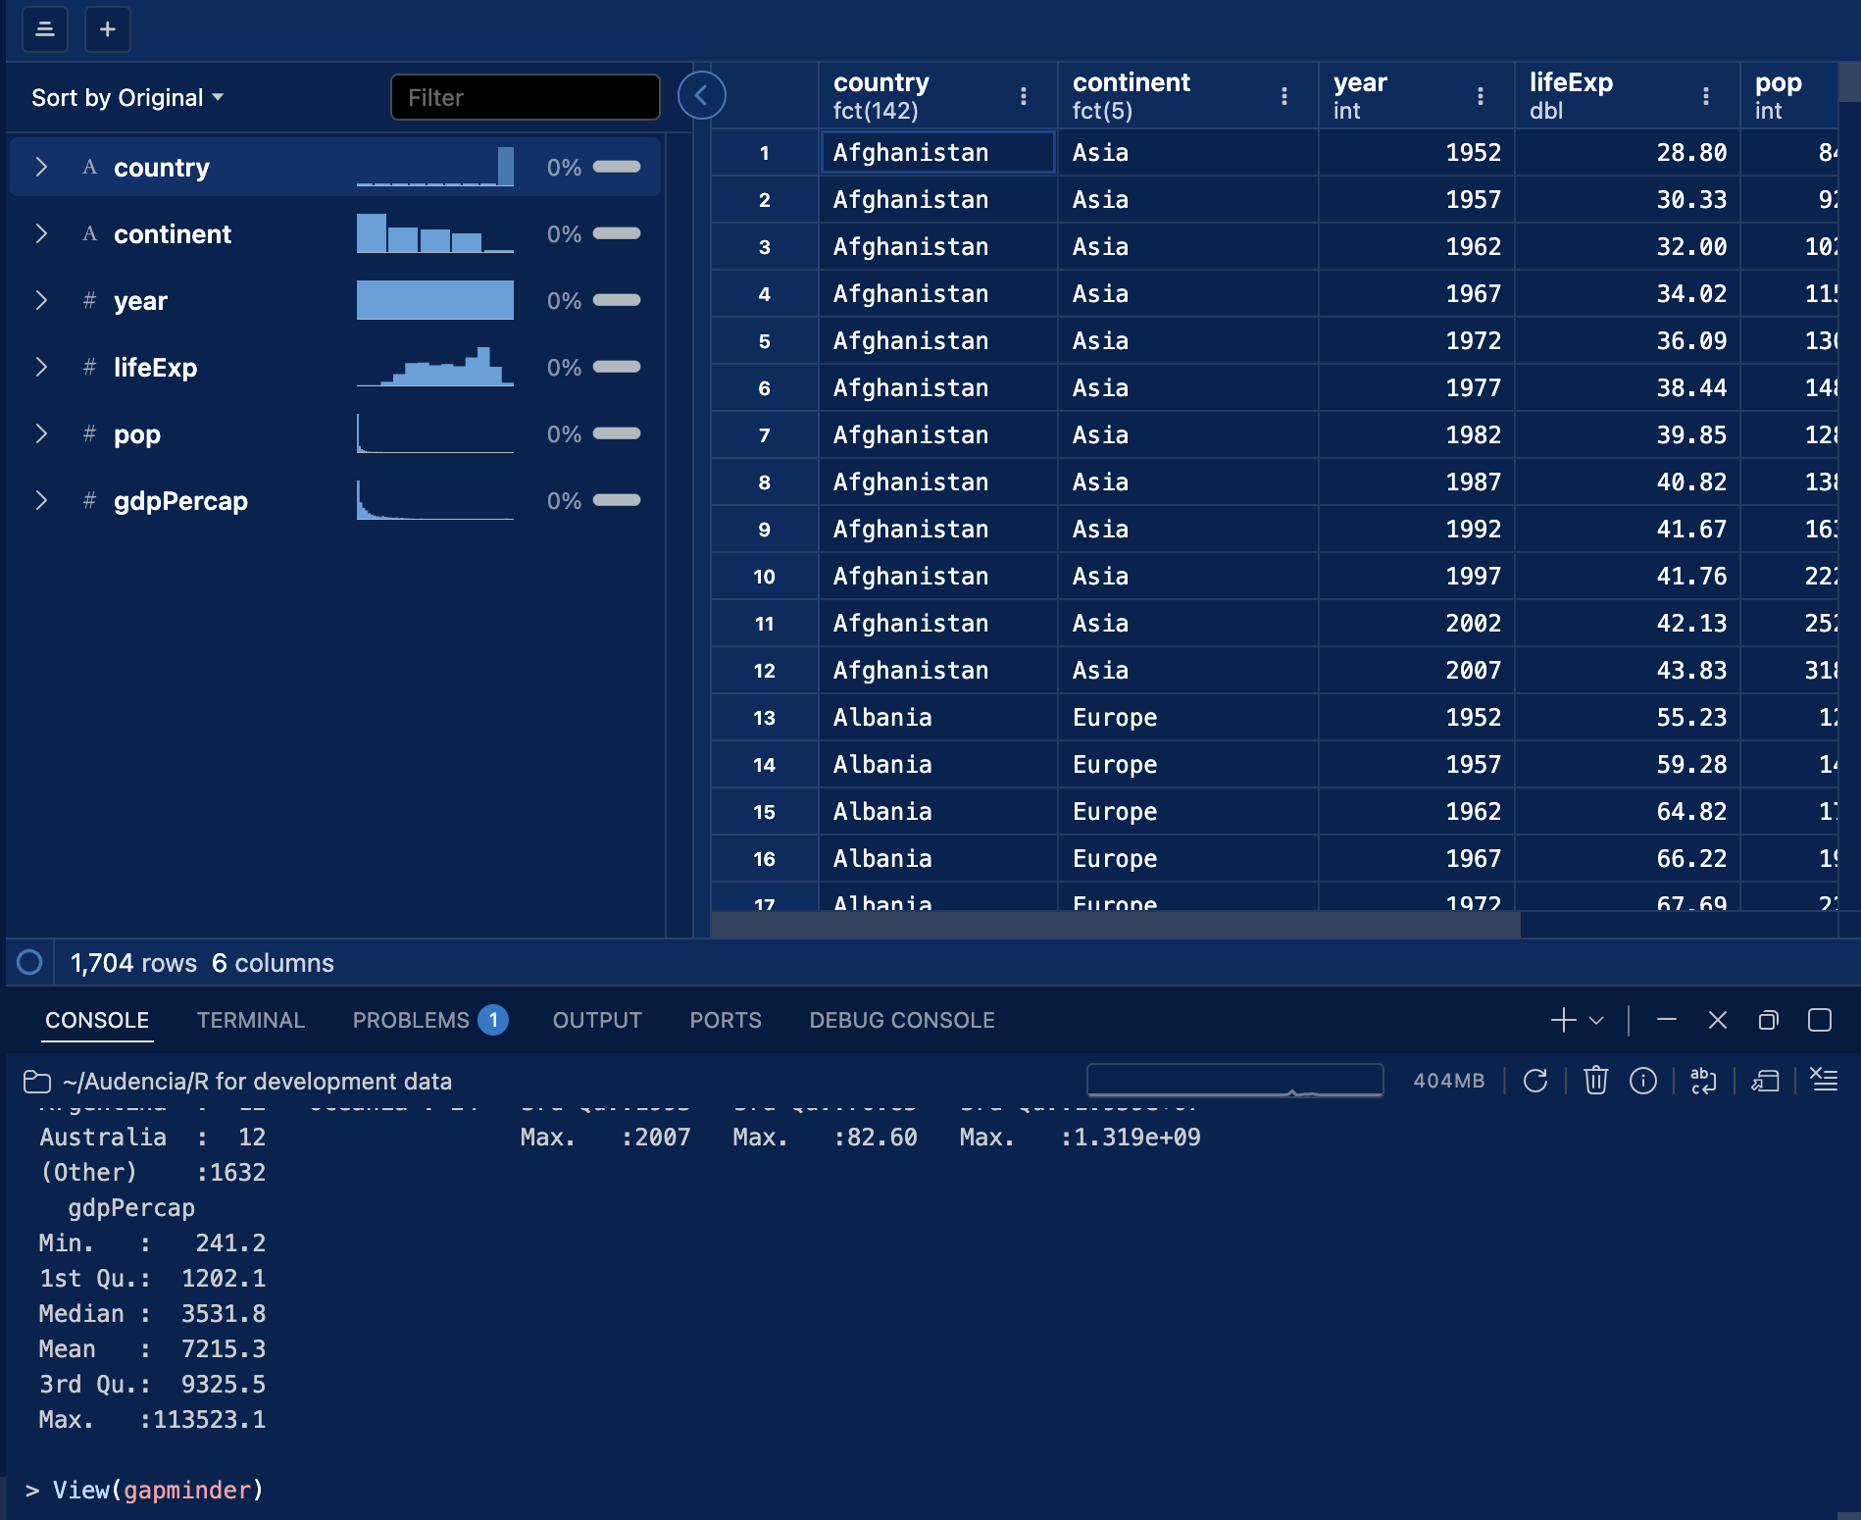
First look at a dataset
GOAL 1 · LOAD DATA
library(gapminder)
glimpse(gapminder)
summary(gapminder)
View(gapminder)
Four questions, every time:
How many rows and columns?
What is one row?
What type is each column?
Where are the missing values?
Notes:
11:15 to 11:20. Hadley’s point from this morning applies directly: whether you or an AI wrote the code, look at the data. The Data Explorer makes this easy: sort, filter and see each column’s distribution without writing code.

Slide 56
Five verbs cover most analysis in tidyverse
GOAL 2 · ANALYSE · R4DS CHAPTER 3
VERB
WHAT IT DOES
EXAMPLE ON GAPMINDER
filter()
keeps rows that match a condition
filter(year == 2007)
arrange()
reorders rows
arrange(desc(gdpPercap))
select()
keeps or drops columns
select(country, lifeExp)
mutate()
adds new columns
mutate(gdp = pop * gdpPercap)
summarise()
collapses rows into a summary
summarise(mean_le = mean(lifeExp))
Plus group_by(), which makes any of them work per group: per continent, per year, per country.
Notes:
11:20 to 11:22. All verbs share a pattern: the first argument is a data frame, the rest describe what to do using column names without quotes, and the result is a new data frame. The original is never changed unless you save over it.

Slide 57
The pipe |> means “and then”
GOAL 2 · ANALYSE · R4DS CHAPTER 3
flights |>
filter(dest == "IAH") |>
group_by(year, month, day) |>
summarize(
arr_delay = mean(arr_delay,
na.rm = TRUE)
)
READ IT OUT LOUD
Take flights,
and then keep flights to Houston (IAH),
and then group them by day,
and then compute the average arrival delay.
You will also see %>% online which is an older (non-native) version of the |> pipe, it functions essentially the same.
Notes:
11:22 to 11:26. This is the opening example of R for Data Science chapter 3. Run it, then remove one line at a time to show what each step does. Reading code out loud is also the best way to check AI-written code.

Slide 58
Working with rows: filter() and arrange()
GOAL 2 · ANALYSE · ROWS
# delayed more than two hours
flights |> filter(dep_delay > 120)
# January 1st
flights |> filter(month == 1 & day == 1)
# January or February
flights |> filter(month %in% c(1, 2))
# most delayed first
flights |> arrange(desc(dep_delay))
==
is equal to
&
and
|
or
%in%
is one of
CLASSIC MISTAKE
filter(month = 1) using only one equals sign. R will throw an error explaining this.
Notes:
11:26 to 11:31. After each line, ask: how many rows are left? Then do the same on gapminder: filter(continent == "Africa", year == 2007).

Slide 59
Working with columns: select() and mutate()
GOAL 2 · ANALYSE · COLUMNS
# keep a few columns
flights |> select(year, month, day)
flights |> select(year:day)
# create new ones
flights |>
mutate(
gain = dep_delay - arr_delay,
speed = distance / air_time * 60,
.before = 1
)
select() changes which columns you see. mutate() calculates new ones from existing columns.
.before = 1 puts new columns first, so you can see them.
ON GAPMINDER
mutate(gdp = pop * gdpPercap)
Notes:
11:31 to 11:35. Speed in miles per hour: distance is in miles, air_time in minutes. Units matter: in development data always check whether GDP is in current or constant prices, and per capita or total.

Slide 60
Comparing groups: group_by() and summarise()
GOAL 2 · ANALYSE · GROUPS
flights |>
group_by(month) |>
summarize(
avg_delay = mean(dep_delay,
na.rm = TRUE),
n = n()
)
OUTPUT, FIRST ROWS
month | avg_delay | n
1 | 10.0 | 27004
2 | 10.8 | 24951
3 | 13.2 | 28834
… | … | …
Always report n next to an average: a mean of three observations is not a mean of three thousand.
flights |> count(dest, sort = TRUE)
Notes:
11:35 to 11:40. Run it live to confirm the numbers. Then on gapminder: gapminder |> filter(year == 2007) |> group_by(continent) |> summarise(median_le = median(lifeExp), n = n()). Oceania has only two countries: a good example of why n matters.

Slide 61
Missing values: NA
GOAL 2 · ANALYSE · A COMMON TRAP
mean(c(2, NA, 4))
#> [1] NA
mean(c(2, NA, 4), na.rm = TRUE)
#> [1] 3
# cancelled flights have no dep_time
flights |> filter(is.na(dep_time))
Missing is not zero.
A country that did not report its poverty rate is not a country with no poverty. Dropping it silently changes your average and your story.
Count missing values before you average: sum(is.na(x))
Remove them with: drop_na(x)
Notes:
11:40 to 11:44. NA is contagious: any calculation with NA gives NA, which is R protecting you. na.rm = TRUE is a decision, not a fix. Ask: which countries are missing, and are they missing at random? Usually not: the poorest or most fragile countries tend to have the least data.

Slide 62
Your turn, in pairs
GOALS 1 AND 2 · QUICK PRACTICE · GAPMINDER
10 minutes
1
Keep only the year 2007
BONUS
2
Which continent has the highest median life expectancy? How many countries is that based on?
How did life expectancy change in the country of your choice between 1952 and 2007?
3
Add a column gdp = pop * gdpPercap, then list the five African countries with the largest total GDP
Notes:
11:44 to 11:54. No AI yet. Task 2 should surface the Oceania problem: only two countries, so n matters. Show one solution live in the last two minutes. This short practice is a warm-up: the real exercise is the afternoon project.

Slide 63
Build a plot
BLOCK 3 · PART 2
Goal 3: from a question to a clear, labelled chart, before lunch
Notes:
11:54. About 36 minutes for plotting, following R for Data Science chapter 1, then applying it to gapminder.

Slide 64


The grammar of graphics
GOAL 3 · PLOT · CONCEPTS
+
Aesthetics
+
Geoms
+
Data
Extras
a tidy data frame
columns mapped to x, y, colour, size
the marks: points, lines, bars
scales, labels, themes
ggplot(data = <DATA>, mapping = aes(<MAPPINGS>)) +
<GEOM_FUNCTION>()
Notes:
11:54 to 11:57. Every ggplot is built from these layers, added with a plus sign. Once students see the template, every chart is a variation on it. This is also why AI writes ggplot code well: it is a small, consistent grammar.

Slide 65
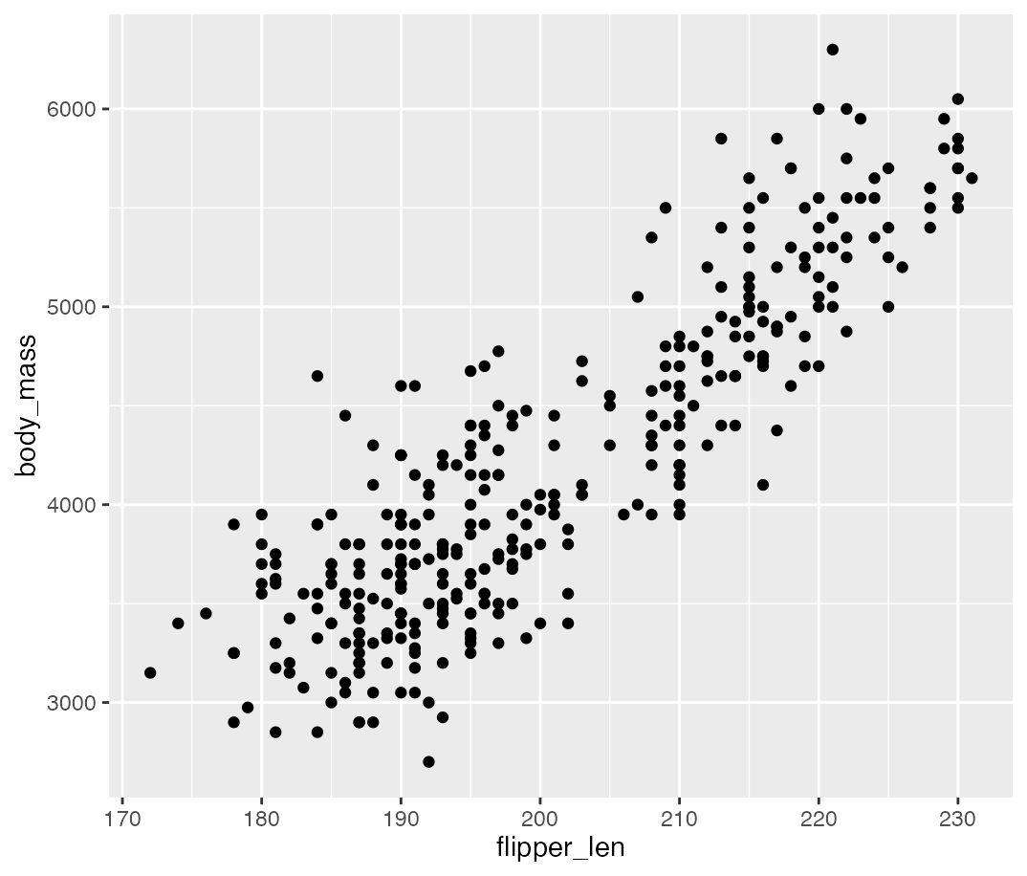
Do penguins with longer flippers weigh more?
GOAL 3 · PLOT · R4DS CHAPTER 1
# 1. an empty canvas
ggplot(data = penguins)
# 2. map variables to x and y
ggplot(penguins,
aes(x = flipper_len, y = body_mass))
# 3. add a layer of points
ggplot(penguins,
aes(x = flipper_len, y = body_mass)) +
geom_point()
Notes:
11:57 to 12:03. Load library(palmerpenguins) first. Run each stage and let students predict what appears. Point out the warning about 2 removed rows: those penguins have missing measurements, the same NA lesson from a few minutes ago.

Slide 66
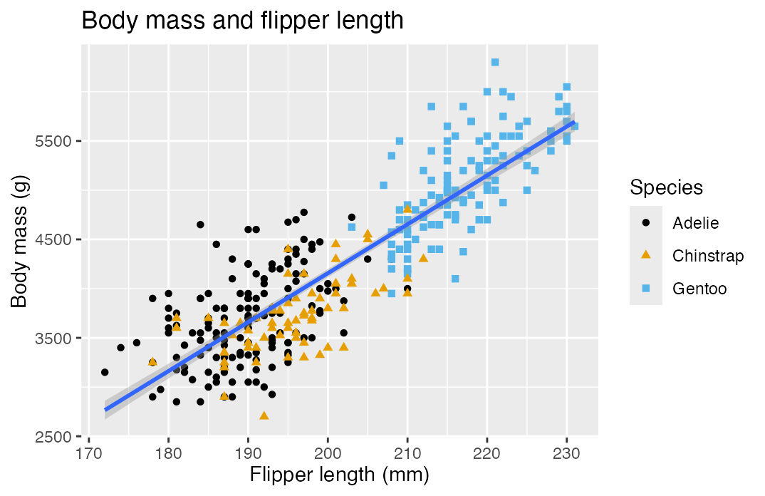
Adding colour, a trend line and labels
GOAL 3 · PLOT · R4DS CHAPTER 1
ggplot(penguins,
aes(x = flipper_length_mm, y = body_mass_g)) +
geom_point(aes(color = species, shape = species)) +
geom_smooth(method = "lm") +
labs(
title = "Body mass and flipper length",
x = "Flipper length (mm)",
y = "Body mass (g)",
color = "Species", shape = "Species"
) +
ggthemes::scale_color_colorblind()
aes() inside geom_point() applies to that layer only, so you get one trend line, not three.
Colour plus shape stays readable in black and white.
Notes:
12:03 to 12:09. This is the final plot of R for Data Science chapter 1. Ask: what happens if you move color = species into the top aes()? (Three trend lines, one per species.) Let students try it.

Slide 67
Start from the question, then pick the geom
GOAL 3 · PLOT · CHOOSING
YOUR QUESTION
VARIABLES
GEOM
How is GDP per capita spread out?
one numeric
geom_histogram()
How many countries per continent?
one category
geom_bar()
Does life expectancy differ by continent?
numeric by group
geom_boxplot()
Is income linked to life expectancy?
two numeric
geom_point()
How has life expectancy changed?
numeric over time
geom_line()
Notes:
12:09 to 12:12. Quick live demo of two of these on gapminder, for example a boxplot of lifeExp by continent for 2007 and a line for one country over time. The question comes first, the chart type follows.

Slide 68
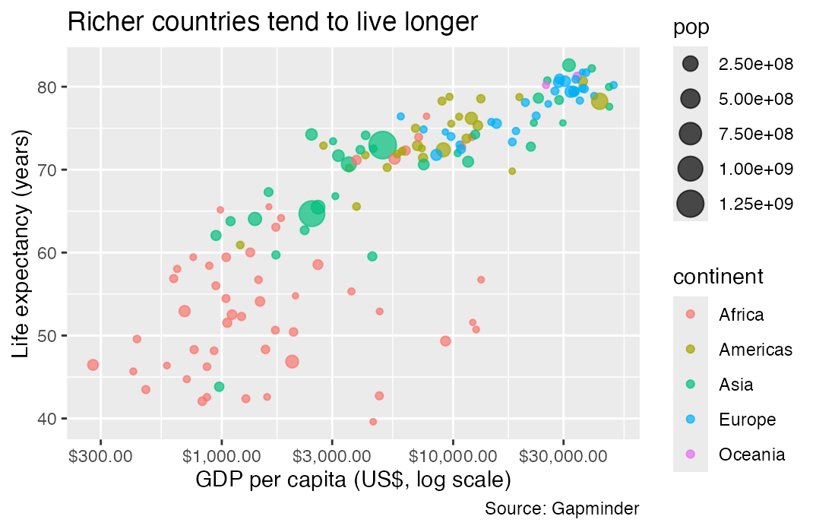
Income and life expectancy in 2007
GOAL 3 · PLOT · DEVELOPMENT EXAMPLE
gapminder |>
filter(year == 2007) |>
ggplot(aes(x = gdpPercap, y = lifeExp)) +
geom_point(aes(size = pop, color = continent),
alpha = 0.7) +
scale_x_log10(labels = scales::label_dollar()) +
labs(
title = "Richer countries tend to live longer",
x = "GDP per capita (US$, log scale)",
y = "Life expectancy (years)",
caption = "Source: Gapminder"
)
Why a log scale? Incomes range from hundreds to tens of thousands of dollars; on a linear axis most countries crowd into one corner.
Notes:
12:12 to 12:18. Build it up layer by layer as with the penguins. The next slide asks the room what the chart does not show.

Slide 69
Look at the bubble chart again. What does it not show?
QUESTION FOR THE ROOM
IF YOU ARE STUCK
Quality of life within countries
Cause and effect
What happened after 2007
How the data were collected
Notes:
12:18 to 12:22. Go back one slide if needed so the chart is visible. This is the critical reading that AI cannot do for them. It also rehearses the “one caveat” part of the afternoon presentations.

Slide 70
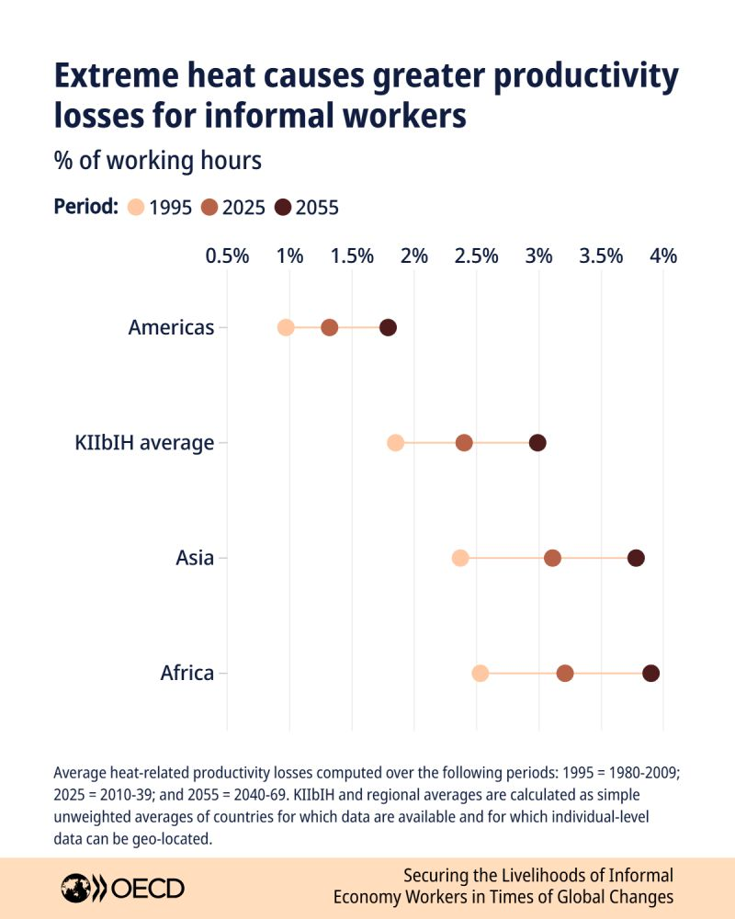
Charts that policy makers can read
GOAL 3 · PLOT · COMMUNICATING
1
One message per chart with the title stating it
2
Label axes or subtitle with units and always cite the source
3
Look for colour-blind-safe palettes or use shapes rather than relying on colour alone
4
Keep it simple as possible
5
Bar charts start at zero and compare like with like
6
Note any caveats or exceptions in the plot caption
Notes:
12:22 to 12:26. Your own before and after example is the most persuasive thing you can show here. These five rules are also the checklist for the afternoon plots.

Slide 71
Saving and sharing your plot
GOAL 3 · PLOT · SHARING
p <- ggplot(gapminder, aes(gdpPercap, lifeExp)) + geom_point()
ggsave("outputs/life-exp-gdp.png", plot = p,
width = 8, height = 5, dpi = 300)
PNG for slides
Save from code
Next step: Quarto
PDF or SVG for print. Size is in inches by default.
Not by screenshot: rerun the script and the figure updates.
Text, code and charts in one reproducible report.
Notes:
12:26 to 12:30. Everyone saves one plot now: the afternoon project ends with exactly this step. Quarto is a pointer for later in the module.

Slide 72
Lunch
Back at 13:45
This afternoon in groups of four, you will analyse real development data and present one plot.
Notes:
12:30 to 13:30. If you can, form the groups before lunch so they can sit together when they come back: mix experience levels using the morning show of hands.

Slide 73
Your turn: a mini data project
BLOCK 4
In groups of four: pick a dataset, clean it, analyse it, and present one plot
Notes:
13:30. Two hours: about 10 minutes of briefing, 65 minutes of group work, 30 minutes of presentations and 10 minutes to close. Point back to the development questions students shared at 08:12.

Slide 74




Answer one question with real data
AFTERNOON PROJECT · THE BRIEF
1
Form groups of four and pick dataset A, B or C
Groups of four
2
About ten groups for the class
Load it straight from the web with read_csv() (no need to download)
3
Clean only what your question needs
Deliverable
One PNG in the shared folder, and the script
4
Summarise with group_by() and summarise()
Presentation
5
Make one plot whose title states your finding
Two minutes per group, no slides
AI allowed
With the rules on the AI slide
Notes:
13:30 to 13:33. Mix experience levels inside groups: use the morning show of hands. One laptop types, the others read the data dictionary, check the output and plan the chart; rotate the typist every 20 minutes.

Slide 75
Two hours, step by step
AFTERNOON PROJECT · TIMELINE
Time | Step
13:45 to 13:55 | Brief, form groups, pick a dataset
13:55 to 14:15 | Explore: glimpse(), count(), missing values
14:15 to 15:00 | Clean, summarise, plot
15:00 to 15:05 | Save with ggsave() and upload
15:05 to 15:35 | Presentations, two minutes each
15:35 to 15:45 | Wrap-up
Running late? A simple chart that answers your question beats a beautiful one that does not exist.
Notes:
13:33 to 13:35. Is two hours enough? Yes, with three conditions: the data load from a link (no downloads), groups of four so there are about ten presentations rather than twenty, and all plots collected in one shared folder so you present from one laptop with no changeovers. Ten groups at two and a half minutes each is 25 minutes.

Slide 76
Pick one of three datasets
AFTERNOON PROJECT · CHOOSE YOUR DATA · TIDYTUESDAY
A
B
C
Forced displacement
Tuberculosis
Crop yields
WHO · by country and year
Our World in Data · since 1961
UNHCR · 2010 to 2022
Where is TB falling, and where is it not?
Is food production catching up everywhere?
Who is displaced, and where do they go?
Cleaning: medium
Cleaning: light
Cleaning: medium
TidyTuesday is a weekly community project that publishes a cleaned, documented dataset. All three load with one line of R.
Notes:
13:35 to 13:40. Ask for a show of hands per dataset to check the spread; it is fine if one is more popular. B is the gentlest for beginners; A and C need a little more cleaning. The next three slides are reference slides: leave them up on the screen or share the PDF, rather than presenting each one.

Slide 77
A · Forced displacement (UNHCR)
AFTERNOON PROJECT · OPTION A · TIDYTUESDAY, 22 AUGUST 2023
Source: UNHCR Refugee Population Statistics, via the refugees R package
QUESTION IDEAS
One row: one country of origin, one country of asylum, one year
Which ten countries hosted the most refugees in 2022?
How has displacement changed since 2010?
Where do refugees from one origin country go?
Key columns: year, coo_name (origin), coa_name (asylum), refugees, asylum_seekers, idps
Watch out: many zeros and missing values; numbers are per pair of countries, so sum() them; official country names can be long
tt <- "https://raw.githubusercontent.com/rfordatascience/tidytuesday/main/data/"
refugees <- read_csv(paste0(tt, "2023/2023-08-22/population.csv"))
Data dictionary: github.com/rfordatascience/tidytuesday
Notes:
Reference slide. Typical first step: refugees |> filter(year == 2022) |> group_by(coa_name) |> summarise(total = sum(refugees, na.rm = TRUE)) |> slice_max(total, n = 10). A common mistake is to plot every pair of countries: push groups to summarise first. Test the link on the classroom Wi-Fi beforehand.

Slide 78
B · Tuberculosis burden (WHO)
AFTERNOON PROJECT · OPTION B · TIDYTUESDAY, 11 NOVEMBER 2025
Source: World Health Organization TB burden estimates, via the getTBinR package
QUESTION IDEAS
One row: one country, one year
Which WHO region has the highest TB incidence, and is it falling?
How do TB deaths among people with HIV compare across countries?
Do countries with higher treatment coverage have lower mortality?
Key columns: country, g_whoregion, year, e_inc_100k (new cases per 100,000), e_mort_100k (deaths per 100,000), c_cdr (treatment coverage, %)
Watch out: rates (_100k) versus counts (_num); these are estimates, not counted cases
tt <- "https://raw.githubusercontent.com/rfordatascience/tidytuesday/main/data/"
tb <- read_csv(paste0(tt, "2025/2025-11-11/who_tb_data.csv"))
Data dictionary: github.com/rfordatascience/tidytuesday
Notes:
Reference slide. The gentlest option: the data are already one row per country and year. Good first plot: a line chart of e_inc_100k over year for three or four countries, coloured by country. For the coverage question, a scatter of c_cdr against e_mort_100k for one year. Remind groups that rates are comparable across countries, counts are not.

Slide 79
C · Crop yields (Our World in Data)
AFTERNOON PROJECT · OPTION C · TIDYTUESDAY, 1 SEPTEMBER 2020
Source: Our World in Data, based on UN Food and Agriculture Organization (FAO) data
QUESTION IDEAS
One row: one country or region, one year, with one column per crop
Have maize yields in Africa caught up with other continents since 1961?
Which countries increased rice yields the most?
Where are cassava yields highest, and has that changed?
Key columns: Entity, Code, Year, then 11 crops in tonnes per hectare: wheat, rice, maize, cassava, cocoa…
Watch out: column names contain spaces; regions are mixed with countries (regions have no Code); not every crop grows everywhere
tt <- "https://raw.githubusercontent.com/rfordatascience/tidytuesday/main/data/"
crops <- read_csv(paste0(tt, "2020/2020-09-01/key_crop_yields.csv"))
Data dictionary: github.com/rfordatascience/tidytuesday
Notes:
Reference slide. The best cleaning practice of the three. Suggested first step: crops |> pivot_longer(-c(Entity, Code, Year), names_to = "crop", values_to = "yield") |> mutate(crop = str_remove(crop, " \\(tonnes per hectare\\)")). After that, one row is one entity, one year, one crop, and the rest is filter, group_by and ggplot.

Slide 80
A skeleton to fill in
AFTERNOON PROJECT · STARTER SCRIPT · SCRIPTS/PROJECT.R
library(tidyverse) # 1. LOAD
tt <- "https://raw.githubusercontent.com/rfordatascience/tidytuesday/main/data/"
df <- read_csv(paste0(tt, "...")) # path from your option slide
# 2. LOOK
glimpse(df)
df |> count(year)
# 3. CLEAN
df_clean <- df |>
filter(...) |>
mutate(...)
# 4. SUMMARISE
tbl <- df_clean |>
group_by(...) |>
summarise(...)
# 5. PLOT AND SAVE
p <- ggplot(tbl, aes(...)) +
geom_...() +
labs(title = "...", caption = "Source: ...")
ggsave("outputs/group-01.png", p,
width = 8, height = 5)
R for Development Data · Audencia · Afternoon project
Notes:
Reference slide. Put this skeleton on Moodle or the course repository as project.R so groups start from a file rather than typing it. The structure mirrors the three goals of the day: load, analyse, plot.

Slide 81
Cleaning moves you will probably need
AFTERNOON PROJECT · CLEANING
IF YOU SEE…
TRY
Column names with spaces
rename(maize = `Maize (tonnes per hectare)`)
One column per crop or per year
pivot_longer(-c(Entity, Code, Year))
Regions mixed with countries
filter(!is.na(Code))
Missing values
sum(refugees, na.rm = TRUE)
Too many countries to plot
slice_max(total, n = 10)
Long labels in a bar chart
aes(x = total, y = reorder(country, total))
Unsure if a number is a rate or a count
Read the data dictionary, then say it in your axis title
R for Development Data · Audencia · Afternoon project
Notes:
Reference slide. pivot_longer() and reorder() were not covered this morning: show each in 30 seconds when the first group needs it, then tell the room. Backticks let you use a column name that contains spaces.

Slide 82
Using AI in your project carefully
AFTERNOON PROJECT · AI ALLOWED
If possible, work inside Positron where the assistant can see your data, rather than copy-pasting from a chatbot
Amplify the best parts, not the easiest.
Ask for one step at a time, naming the data frame and columns
Paraphrasing y code for ai?
Run each step and open the result in the Data Explorer
Check the chart against the numbers in your summary table
Keep the final script, and write down what the AI did
R for Development Data · Audencia · Afternoon project
Notes:
13:38 to 13:40, before groups start. Posit Assistant runs inside Positron and needs a Posit AI account or an API key, which costs money; check access before the session. Fallback: a free chatbot, used one step at a time, with every line run and checked. Students who prefer to work without AI should do so.

Slide 83
AFTERNOON PROJECT · KEEP THIS OPEN WHILE YOU WORK
Answer one development question with real data
THE GOALS
1
Load your dataset from its link
THE SKELETON: COPY IT, FILL IN THE ...
2
Choose one question to answer
library(tidyverse)
df <- read_csv(paste0(tt, "...")) # 1 LOAD
glimpse(df) # 2 LOOK
tbl <- df |>
filter(...) |> mutate(...) |> # 3 CLEAN
group_by(...) |> summarise(...) # 4 SUMMARISE
p <- ggplot(tbl, aes(x = ..., y = ...)) + # 5 PLOT
geom_col() +
labs(title = "Your finding",
subtitle = "Your question?",
caption = "Source: ...")
ggsave("group-01.png", p, width = 8, height = 5)
3
Clean only what your question needs
4
Summarise to one row per bar or point
5
One plot whose title states your finding with question in subtitle
Email your PNG to
kategchalmers@gmail.com
# Data links (TidyTuesday) · data dictionaries: github.com/rfordatascience/tidytuesday
tt <- "https://raw.githubusercontent.com/rfordatascience/tidytuesday/main/data/"
refugees <- read_csv(paste0(tt, "2023/2023-08-22/population.csv")) # A · UNHCR displacement
tb <- read_csv(paste0(tt, "2025/2025-11-11/who_tb_data.csv")) # B · WHO tuberculosis
crops <- read_csv(paste0(tt, "2020/2020-09-01/key_crop_yields.csv")) # C · OWID crop yields
Notes:
Leave this slide on the projector from 13:45 while groups work. Groups email their PNG to kategchalmers@gmail.com with their group number in the subject; open the attachments from your inbox to present. Fill in the shared doc link in the orange box before class. pivot_longer() is mainly for option C (one column per crop); slice_max() keeps the top ten countries for a readable bar chart. Remind groups at 14:15, 14:35 and 15:00 where they should be.

Slide 84

Two minutes, one plot
AFTERNOON PROJECT · PRESENTING
15 s
45 s
30 s
30 s
Our question
The plot
One finding
One caveat
and which dataset
what each axis and colour shows
in one sentence
what the data cannot tell us
I show the plots from my laptop, in order from when I received them.
I stop you at two minutes, so rehearse once before 14:50.
R for Development Data · Audencia · Afternoon project
Notes:
Show at 13:40 so groups know the target, then again at 14:50. Group the presentations by dataset (all A, then B, then C): the room sees different answers to related questions, which makes the closing discussion richer. A visible timer helps.

Slide 85

Looking across all the plots: one thing that clicked, one thing still unclear
QUESTION FOR THE ROOM · EVERYONE · 3 MINUTES
Clicked
Still unclear
First sticky note colour
Second sticky note colour
HOW
Write one of each and stick them on the door on your way out, or answer on [Wooclap link].
R for Development Data · Audencia · Wrap-up
Notes:
15:20 to 15:23. Before the sticky notes, ask the room for one pattern that came up in more than one group’s plot. The notes give you the feedback for the next session without a long discussion.

Slide 86


What you did today
WRAP-UP · RECAP
Loaded data
Analysed it
Built a plot
read_csv()
glimpse()
filter() mutate()
group_by() |> summarise()
ggplot() + aes()
geom_point() ggsave()
And you know how to use AI as an amplifier: by reading, running and checking what it writes.
R for Development Data · Audencia · Wrap-up
Notes:
15:23 to 15:26. Return to the three goals from this morning and ask for a show of hands on each.

Slide 87
Keep going
WRAP-UP · RESOURCES
R for Data Science, 2nd edition, free
r4ds.hadley.nz
TO FILL IN
Positron documentation
positron.posit.co
[Course page and materials]
[Office hours or contact]
Hadley Wickham, y code when ai?
tidydesign.substack.com
[Assessment and deadline]
TidyTuesday: a new dataset each week
github.com/rfordatascience
R-Ladies Paris meetups
[Meetup link]
R for Development Data · Audencia · Wrap-up
Notes:
15:26 to 15:28. R for Data Science chapters 1 to 7 cover everything from today in more depth. TidyTuesday is the best way to keep practising with real data.

Slide 88
Thank you. Questions?
WRAP-UP · 15:28
Please take two minutes for the feedback form before you leave.
Kate Chalmers
[Email] · [LinkedIn] · [Course repository]
[Feedback form link or QR code]
Notes:
15:28 to 15:30. The sticky notes from the closing question already give you feedback; the form is optional.

